Slide 1
SWIPE MY RIDE
Team:
Adrian Fehr
Freddie Vincent
Shannon Imbo
Justin Shand
Daniel Mafile’o

Slide 2
Description & features
Login screen
Main interface
Garage Database
Messenger System
Car Upload

Slide 3
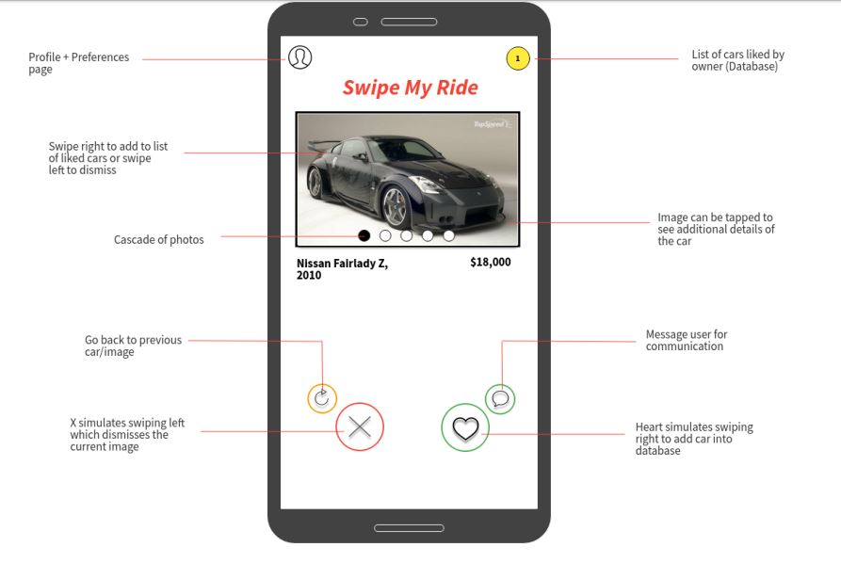
Sprint 0
Meeting the team
Team Agreement
User Stories
Upskilling
Sprint 1 Goal

Slide 4
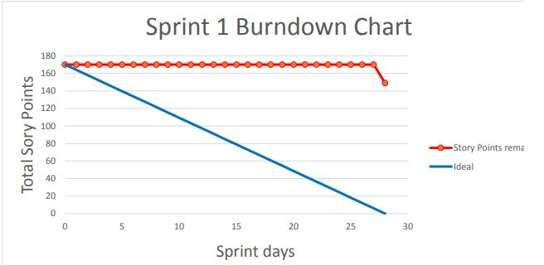
Sprint 1
Developing App
Daily Standups (6)
Burndown Chart
Github and Flutter

Slide 5
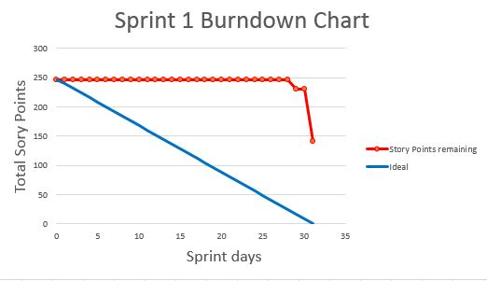
Sprint 2
Sprint 2 goal
New Agreement
Daily Stand Ups (11)
Burndown
Github and Flutter

Slide 6
Scrum process
Activities
Planning poker
Artefacts
Backlog
Roles

Slide 7
Details & roles

Slide 8
Testing + Quality assurance

Slide 9
Development Issues

Slide 10
Future features

Slide 11
Team issues

Slide 12
Lessons learnt

Slide 13
User stories

Slide 14
demonstration
https://trello.com/b/ht4Wqblm/2019s254swipemyride

